Slide 1
Animation Recommendation
By Team 6
Notes:
Matan

Slide 2
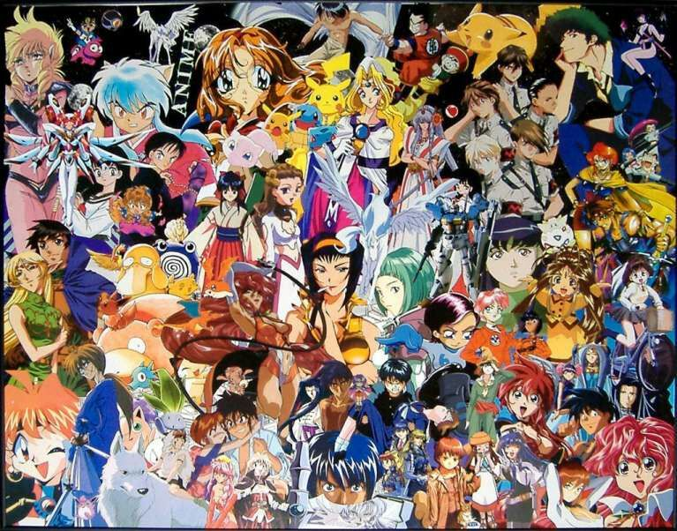



What we all about?
Animation Universe
Notes:
Matan

Slide 3
Why this is important?
Notes:
Matan
In this era of big data, everyone wants to experience customized services, so this project is to explore how to recommend new related anime to users based on analyzing your viewing history

Slide 4
Type of Recommendation System
Collaborative Filtering
Content-Based Filtering
Hybrid Recommendation System
Notes:
Matan
In the real world, many e-commercial and retail company deploy their own recommendation system, but there are three main type of recommendation engine,

Slide 5
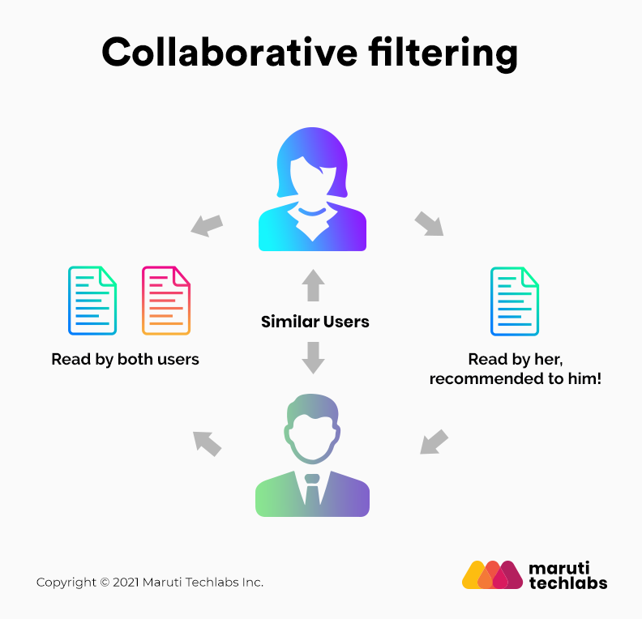
Collaborative Filtering
Notes:
Matan
Source:https://medium.com/mlearning-ai/what-are-the-types-of-recommendation-systems-3487cbafa7c9
Now i am going to talk about what is collaborative filtering, The collaborative filtering method is based on gathering and analyzing data on user’s behavior. This includes the user’s online activities and predicting what they will like based on the similarity with other users.

Slide 6
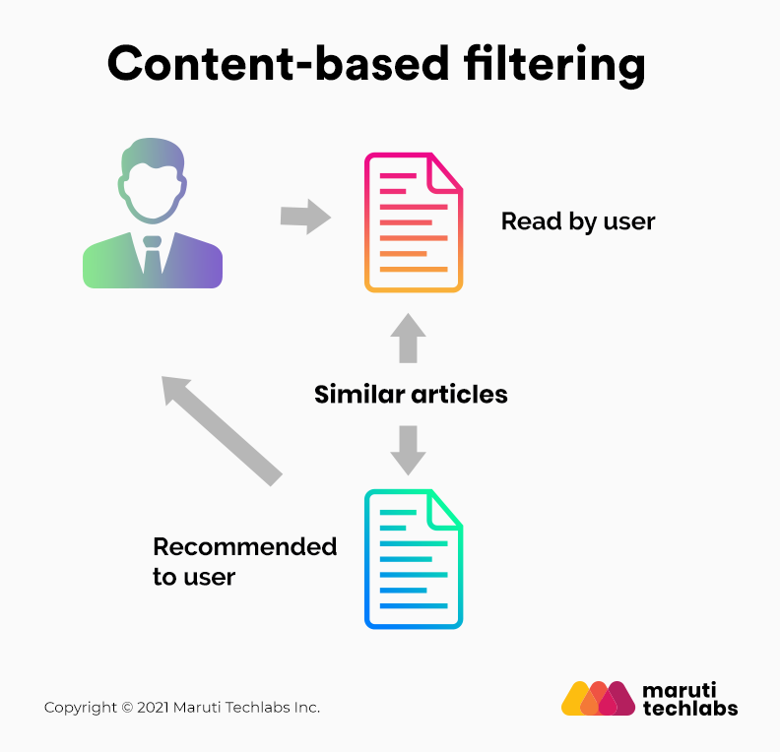
Content-Based
Filtering
Notes:
Matan
Source:https://medium.com/mlearning-ai/what-are-the-types-of-recommendation-systems-3487cbafa7c9
Content-based filtering methods are based on the description of a product and a profile of the user’s preferred choices. In this recommendation system, products are described using keywords, and a user profile is built to express the kind of item this user likes.

Slide 7
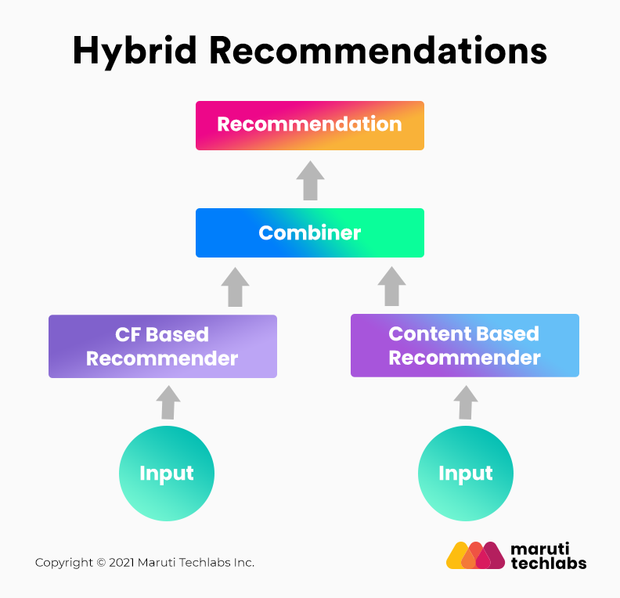
Hybrid
Recommendation System
Notes:
Matan
Source:https://medium.com/mlearning-ai/what-are-the-types-of-recommendation-systems-3487cbafa7c9
In hybrid recommendation systems, products are recommended using both content-based and collaborative filtering simultaneously to suggest a broader range of products to customers.

Slide 8
Data
Handle the NaN Value
2. One Hot Encoding
3. Combine the tables
Notes:
Milton
1)NaN value, i drop them, they have really small part compare to the dataset
2)process of converting the categorical data variables which in turn improve predictions
3)we combine the tables by using common key------user_id

Slide 9

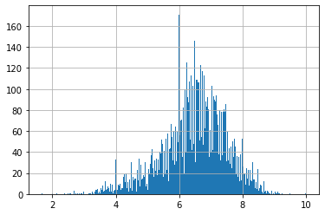
Exploratory Data Analysis
Notes:
Milton

Slide 10

Hypothesis and model
Notes:
Milton
Source: https://buttercup31.medium.com/k-means-clustering-f07b03d46e8a
“grouping of similar data points together and discover patterns in them.”

Slide 11
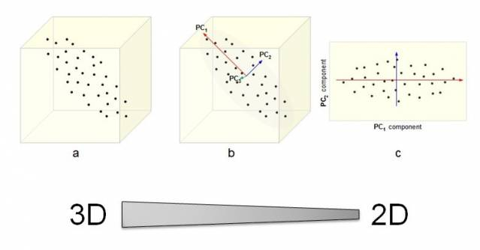
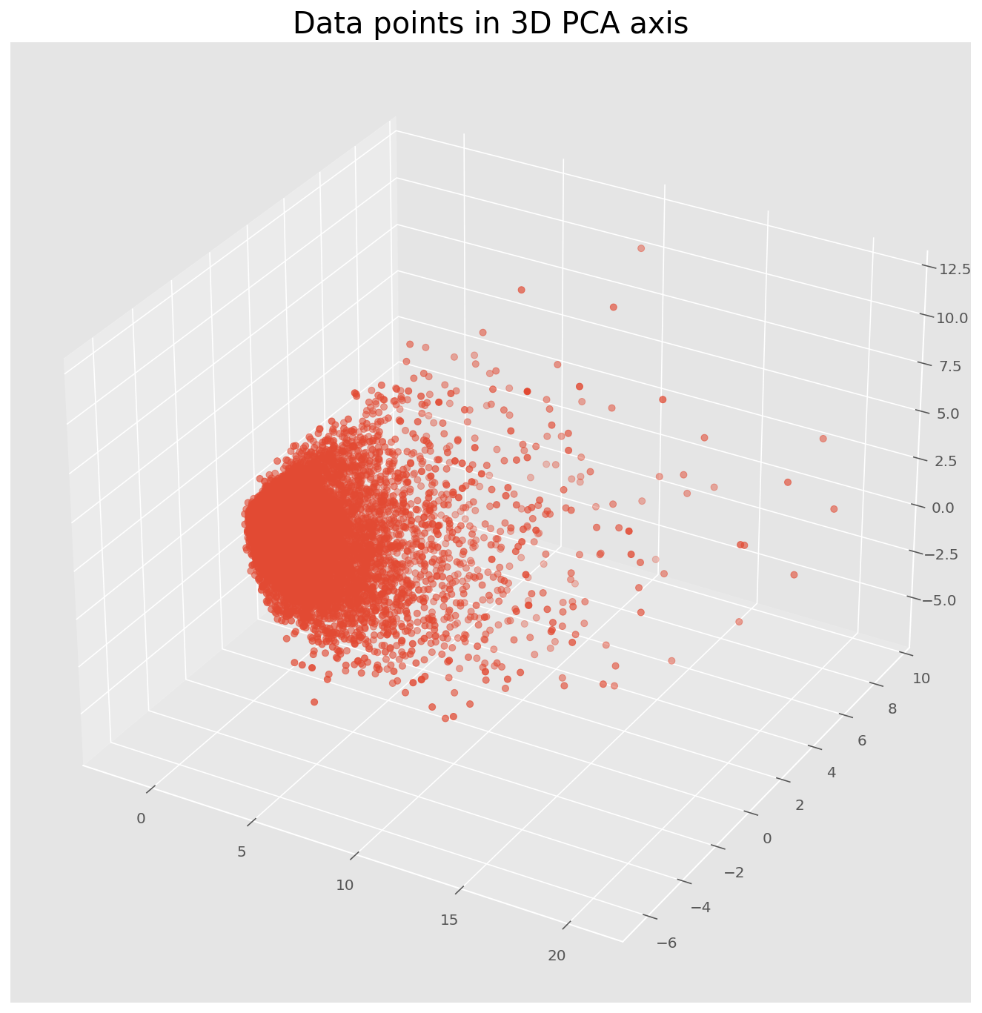
Dimensionality reduction
Principal component analysis (PCA)
Notes:
Milton
source:https://www.davidzeleny.net/anadat-r/doku.php/en:pca
Linear dimensionality reduction using Singular Value Decomposition of the data to project it to a lower dimensional space.

Slide 12
Parameters
n_clustersint
We determine a hypothesis that will later be verified and corroborated. Such as the number of clusters to form
algorithm{“lloyd”, “elkan””}, default=”lloyd”
*IIoyd = EM-style algorithm(Expectation Maximization):
1)Maximization step: Assign points to those cluster centers
2)Expectation step: And then recompute the cluster centers based on those assignments
*elkan =Accelerates k-means by avoiding redundant distance calculations.
init{‘k-means++’, ‘random’}, callable or array-like of shape (n_clusters, n_features), default=’k-means++
Method for initialization:
‘k-means++’
selects initial cluster centers for k-mean clustering
‘‘random’’
choose n_clusters observations (rows) at random from data for the initial centroids
it should be of shape (n_clusters, n_features) and gives the initial centers.
an array is passed
it should take arguments X, n_clusters and a random state and return an initialization.
a callable is passed
Notes:
Milton
IIloyd:
1)Maximization step: (computing Maximum Likelihood cluster center for each point, conversely minimizing Euclidean distance i.e. employing Gaussian noise assumption)
2) Expectation step: (taking the expected value under uniform distribution i.e. the mean).
Elkan:
This is done by using triangle inequality to keep track of lower and upper bounds for distances between points and centers.
++smart way to speed up convergence
*callable is a function-like object

Slide 13
How to find K?
Elbow Method
Notes:
Dylan
The concept is based on SSE (sum of the squared errors) as an indicator to calculate the distance from each point in each group to the center of the cluster

Slide 14
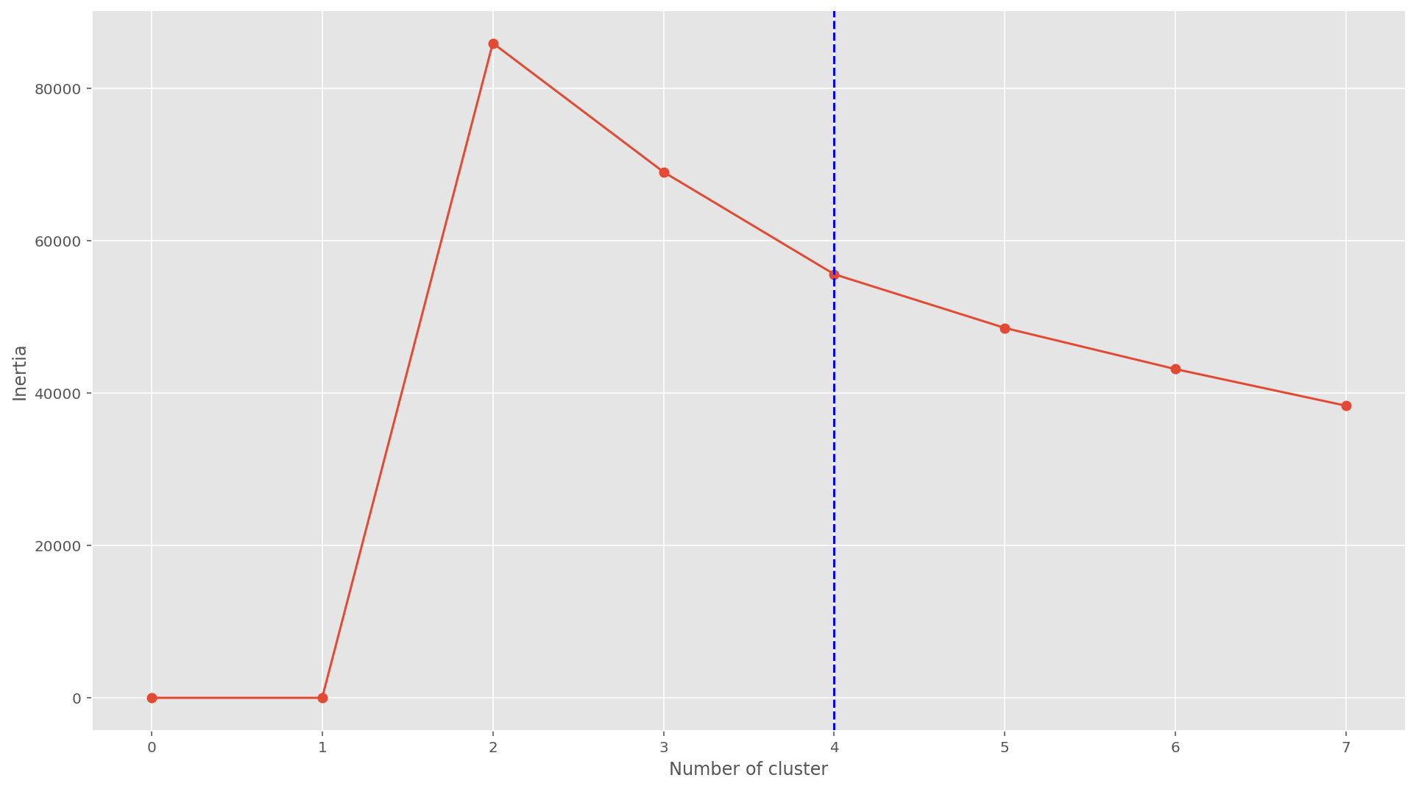
Elbow Method
Notes:
Dylan
The elbow score is lower the better, and there is suppose to have a elbow like turning point in the graph, however, as you can see in our project, the point we are looking for is not obvious, we could still make a estimate that k should between 3 and 4

Slide 15
Evaluation Method
Silhouette Coefficient
Calinski Harabasz Index
Notes:
Dylan
And we will use another method to find the best k value, there are two methods to do that, one is silhouette coefficient, another one is calinski harabasz index. Those two have the same idea to evaluate the model, which is the combination of calculate the points from centroid and distance from each centroid.

Slide 16
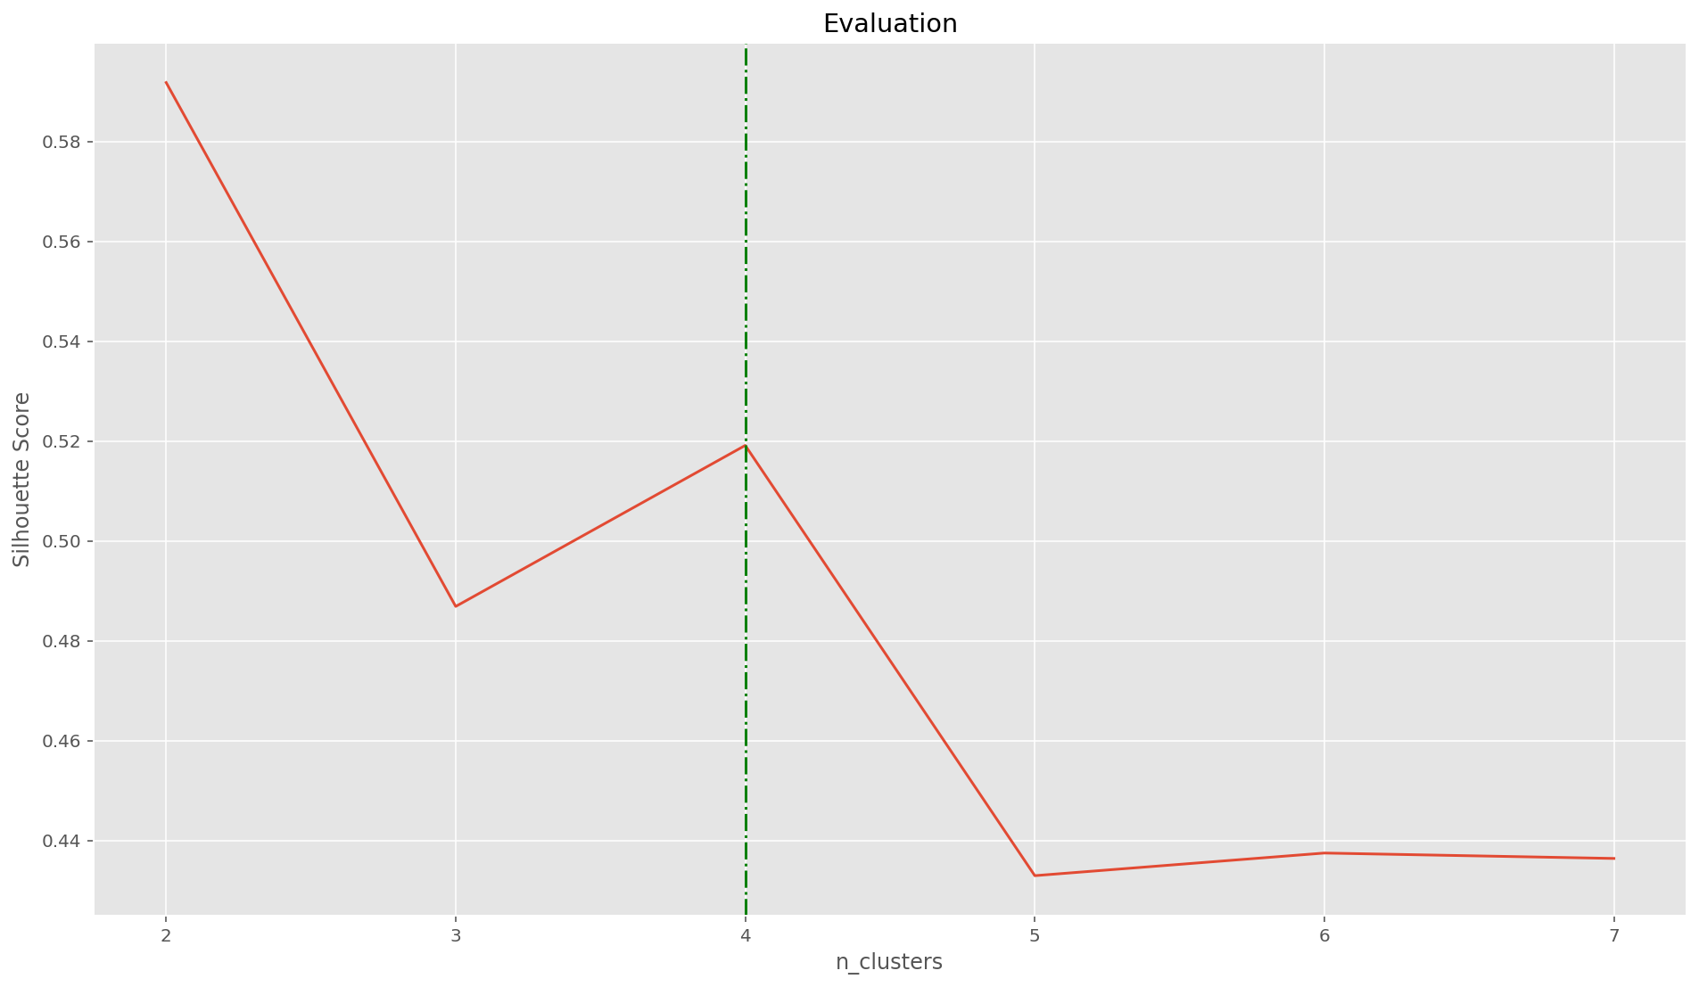
Silhouette Coefficient
Notes:
Dylan
So this is the graph of silhouette coefficient, which is the higher the better, as you can see there is a sharp turning point when the k equals to four, and after that the graph tend to equals to zero when the k go infinity

Slide 17
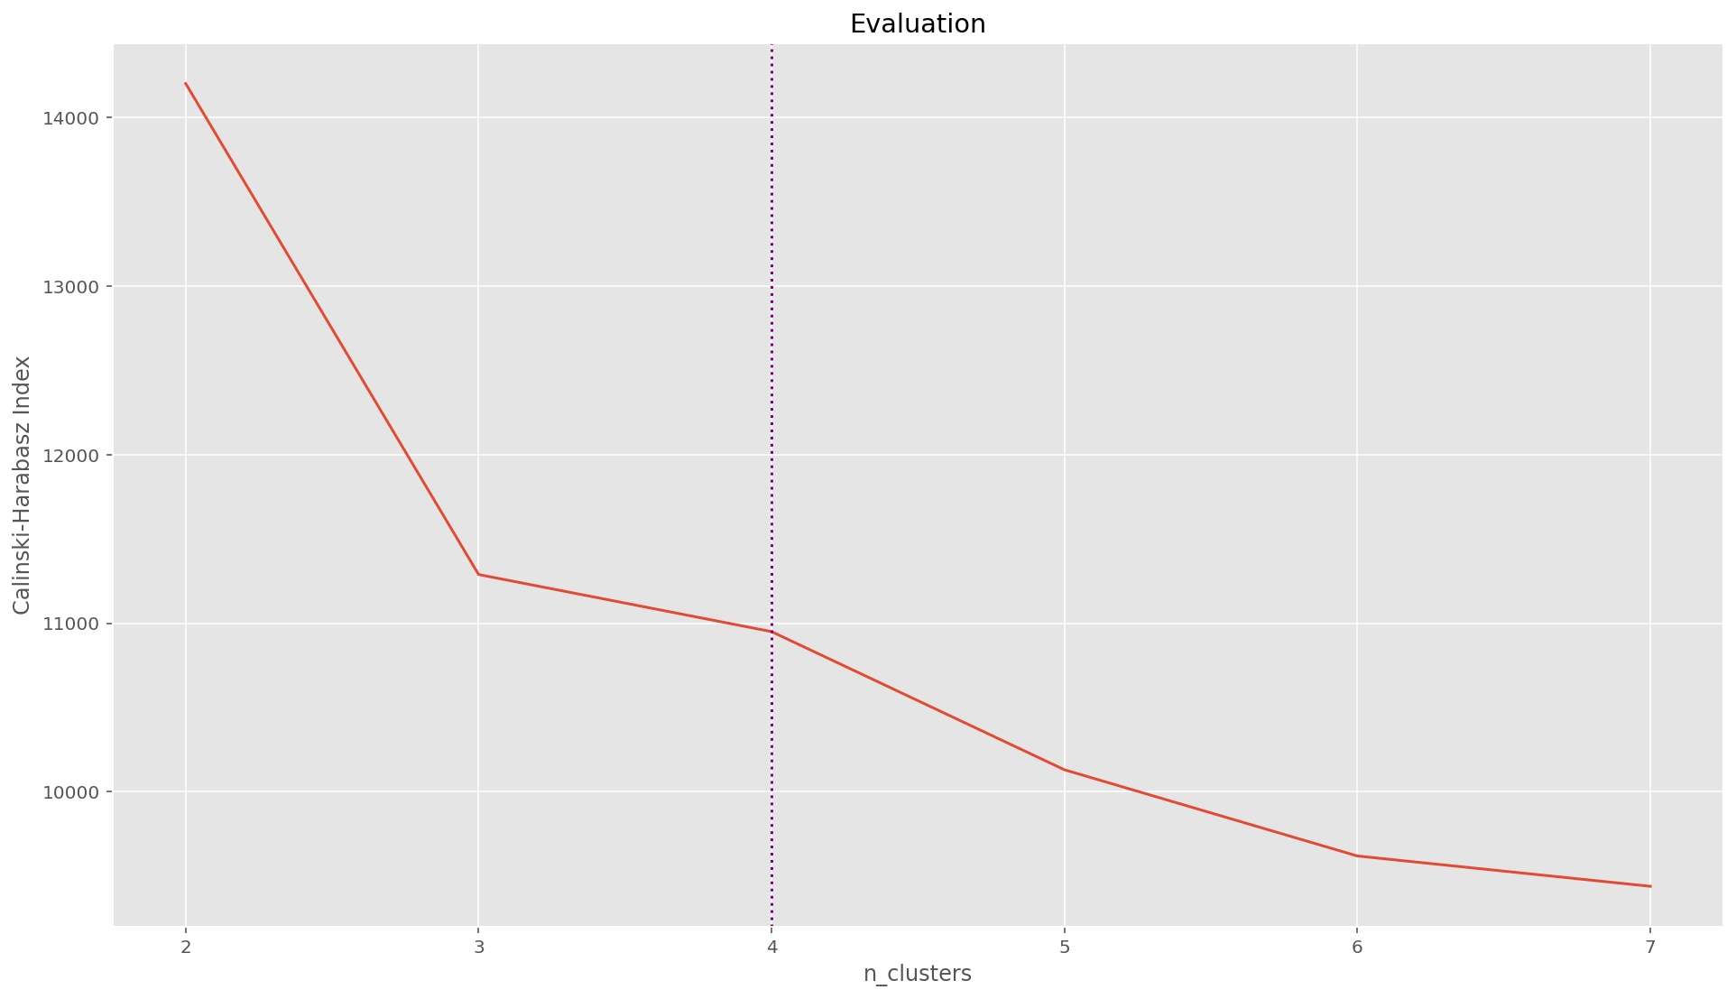
Calinski Harabasz Index
Notes:
Dylan
And this is the graph about Calinski Harabasz index versus k value, as you can see, still the index is higher the better, 3 and 4 both are okay, we made a better choice we combine both criteria result and find the best value which is four.

Slide 18
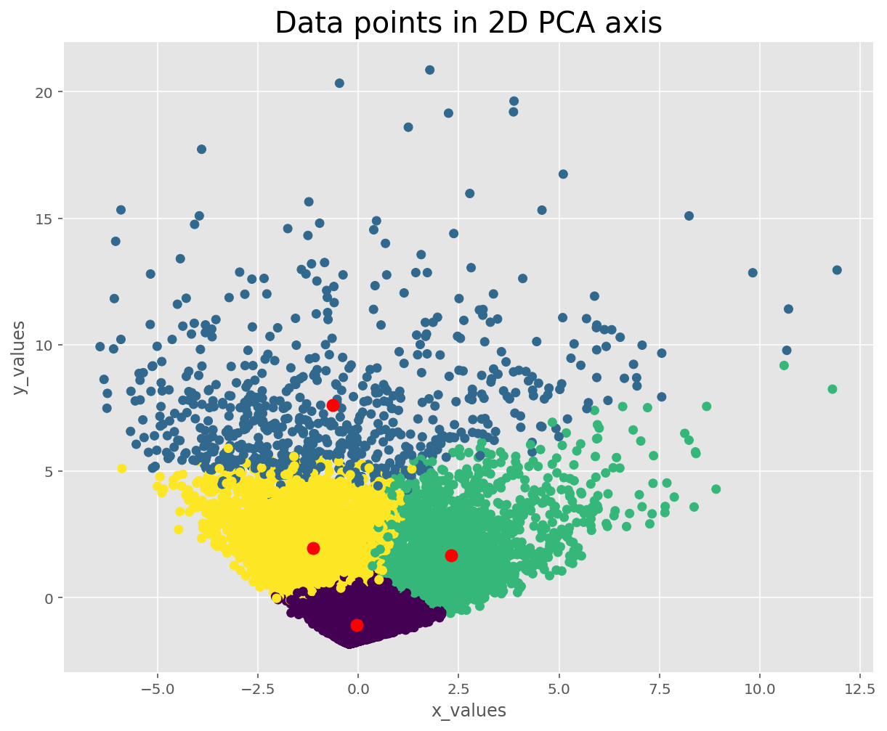
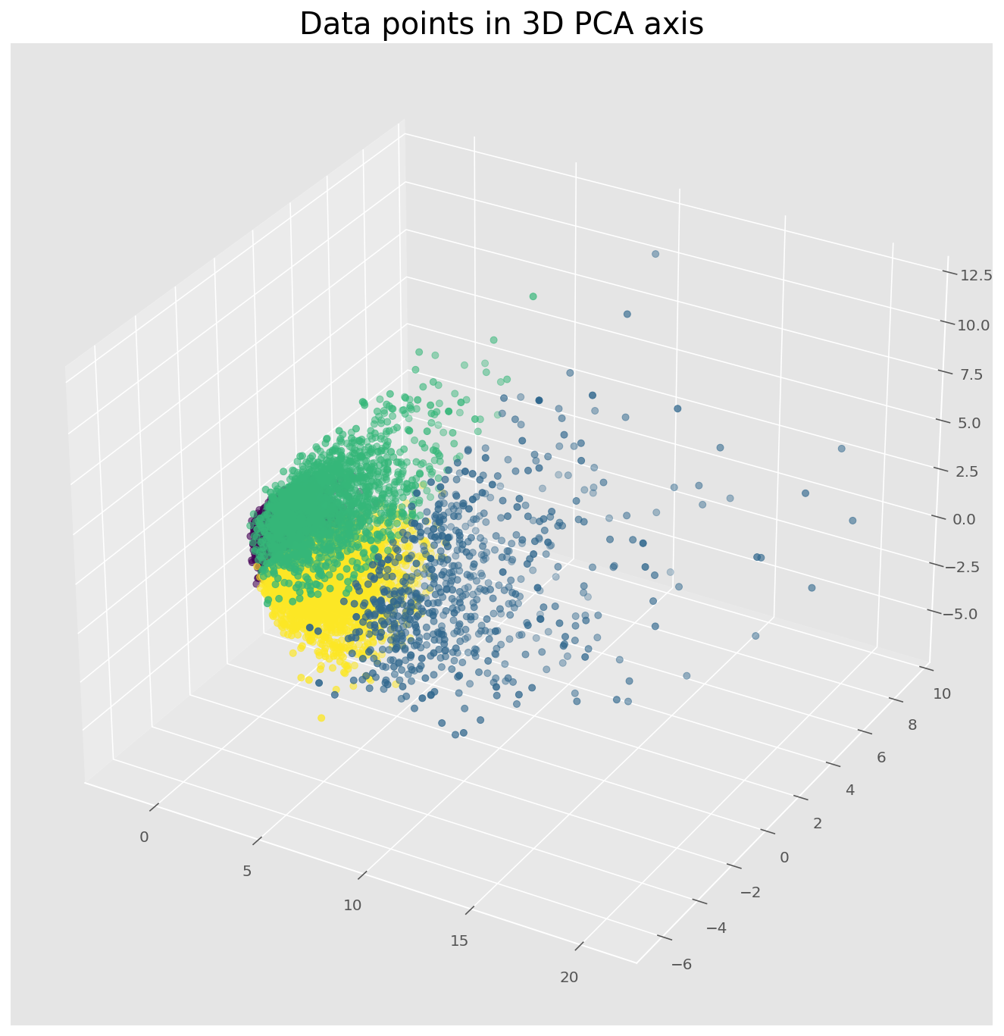
Visualization
Notes:
Dylan
Now let’s see the visualization of the data points in both 2d and 3d version, as you can see the pattern is like a tornado, there are four clusters inside of the data points, each clusters center are marked by using the red dots. Next we will see the genre conclusion of each clusters

Slide 19


Notes:
Dylan
For the first cluster, user who was in the group preferred the genre like romance and drama,school, something like kiminaha
For the second one, user preferred the genre like action, drama and Fantasy, i would say they like Naruto or sth like that

Slide 20

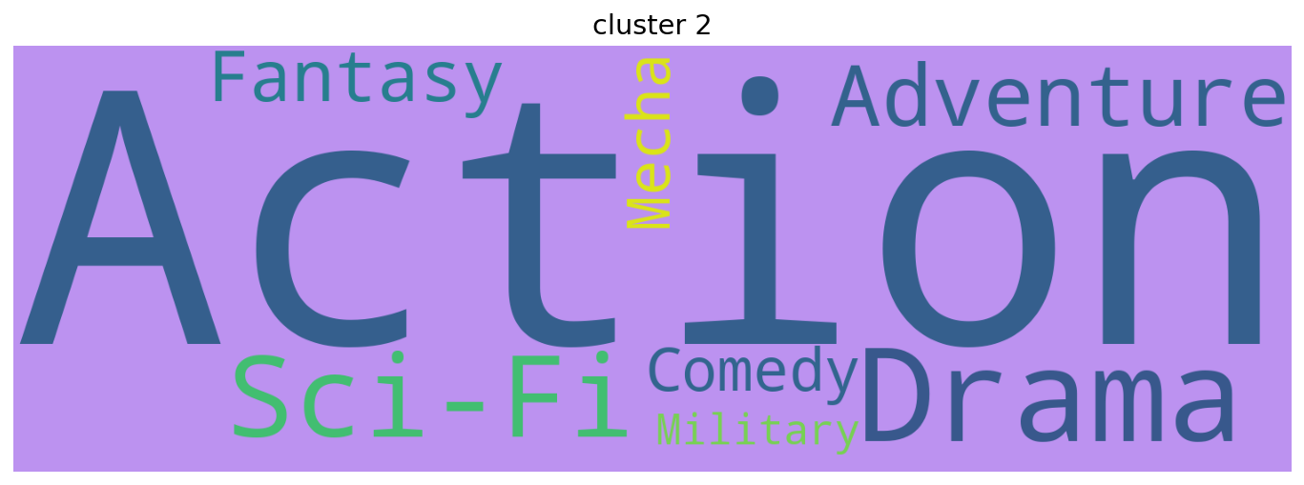
Notes:
Dylan
This also describe the what genre inside of cluster, but as you can see, combine all the result we have, user like the action animes, which verify our hypothesis. So if i have to recommend a anime to a user, the action genre is the first priority.

Slide 21
Future Plan
Using different clustering methods to find the most appropriate method
Implement the model into web app with user interface
Aggregate user feedback and merge into our dataset to create a more personalized experience
Notes:
Matan

Slide 22
Thanks for Watching

